Slide 1
Food Delivery Systems
Tae Hyun Koh
Ryan Jaipersaud

Slide 2





Background
Platform Business Models

Slide 3
Problem Statement
Problem: Food delivery Platforms such as GrubHub increase the costs of transactions by collecting commissions on their service. Fees have been known to average around 13.5% of the price of the food.
Goal: Develop a platform where people can exchange goods without the need for a third party

Slide 4
Blockchain Features
1.) Decentralization limits the role of a third party
2.) Broadcasting Transactions allows for Multi Agent Systems
3.) Helps establish anonymity between users to a certain degree
4.) Cryptographic Hash

Slide 5
Performing a transaction
Customer places order
Restaurant Confirms Order has been received
Restaurant delivers food and confirms that it is delivering to the right customer
Customer confirms the order has been delivered

Slide 6
Tools
Hyperledger Fabric
Allows one to deploy a business network
Allows an admin to add participants
Allows participants to submit transactions
REST API and Local Host
Allows one to view the assets/participant
Allows one to send and receive responses
Angular Framework
Acts like a User Interface

Slide 7
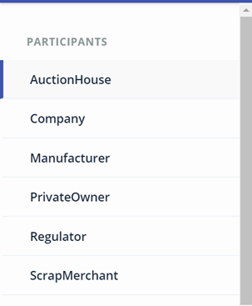
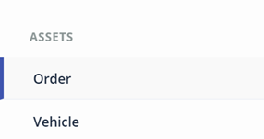
The Role of Hyperledger
Easy connection between Participants and a clear transaction history

Slide 8
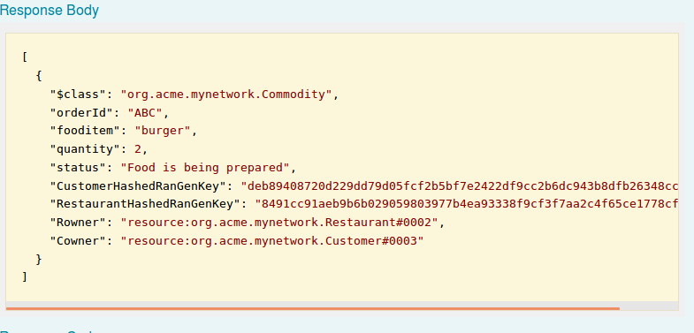
REST API
Contains Get and Post Operations (Receiving and Sending)

Slide 9
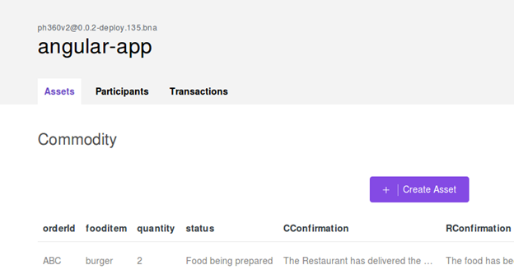
Angular

Slide 10
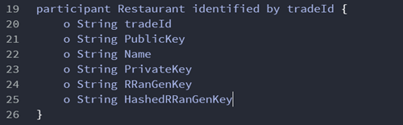
File Type 1: Model File

Slide 11
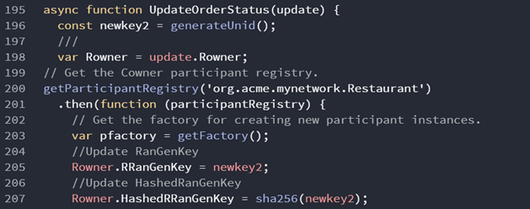
File Type 2: JS File

Slide 12
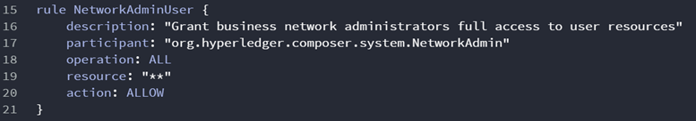
File Type 3: Access File
Contains rules that specify who has access to what information as well as what transactions
Store all file in .bna file

Slide 13
Multi Agent System
Credit Rating System: Scale 0 (poor delivery) to 5 (very good)
Allows people to talk to one another

Slide 14
References
[1] Forbes, P.; GrubHub Charges Restaurants on Average 13.5 % Commission Per Order; https://www.eater.com/2014/3/3/6270739/grubhub-charges-restaurants-an-average-13-5-commission-per-order (accessed April 11th 2018).
[2]Developer Works TV; Hyperledger Composer - Advanced Blockchain Network, https://www.youtube.com/watch?v=FLBZu0BkppU (accessed May 5th, 2017).
[3] IBM; Developer tutorial for creating a Hyperledger Composer Solution, https://hyperledger.github.io/composer/latest/tutorials/developer-tutorial.html (accessed May 5th,2017).

